Slide 1
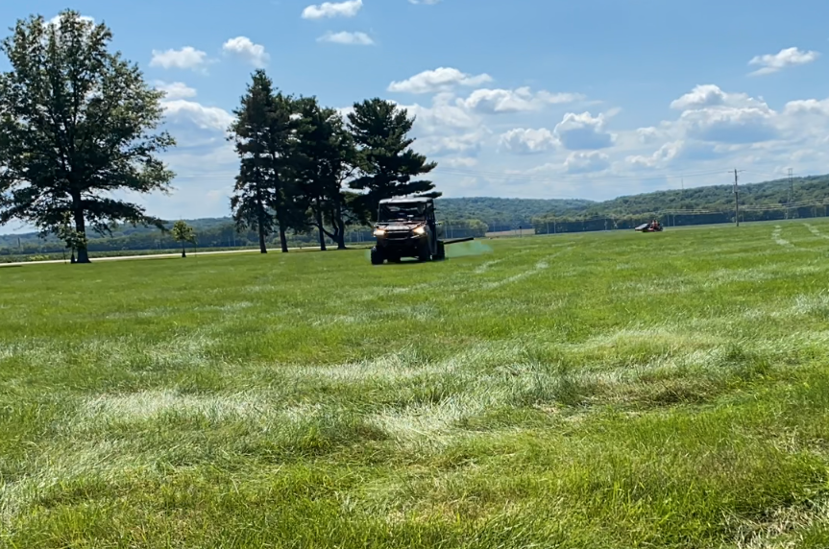
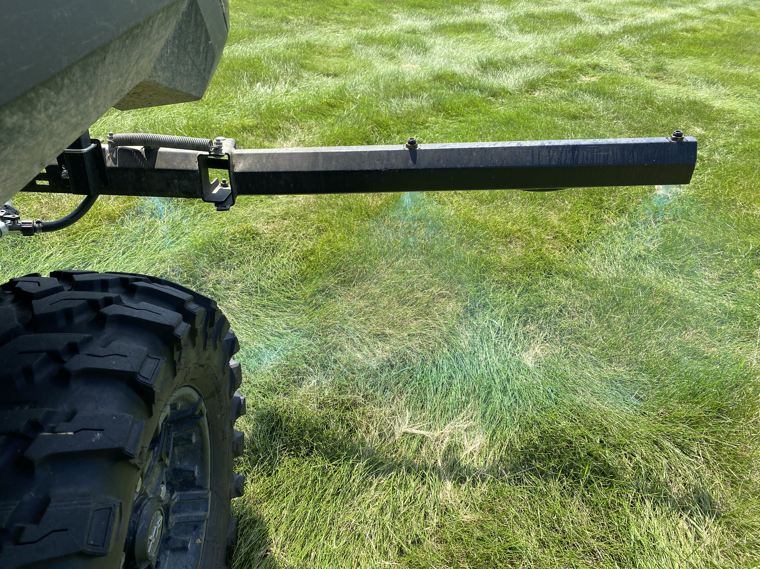
Kill all non-native vegetation to prepare for seed

Slide 2
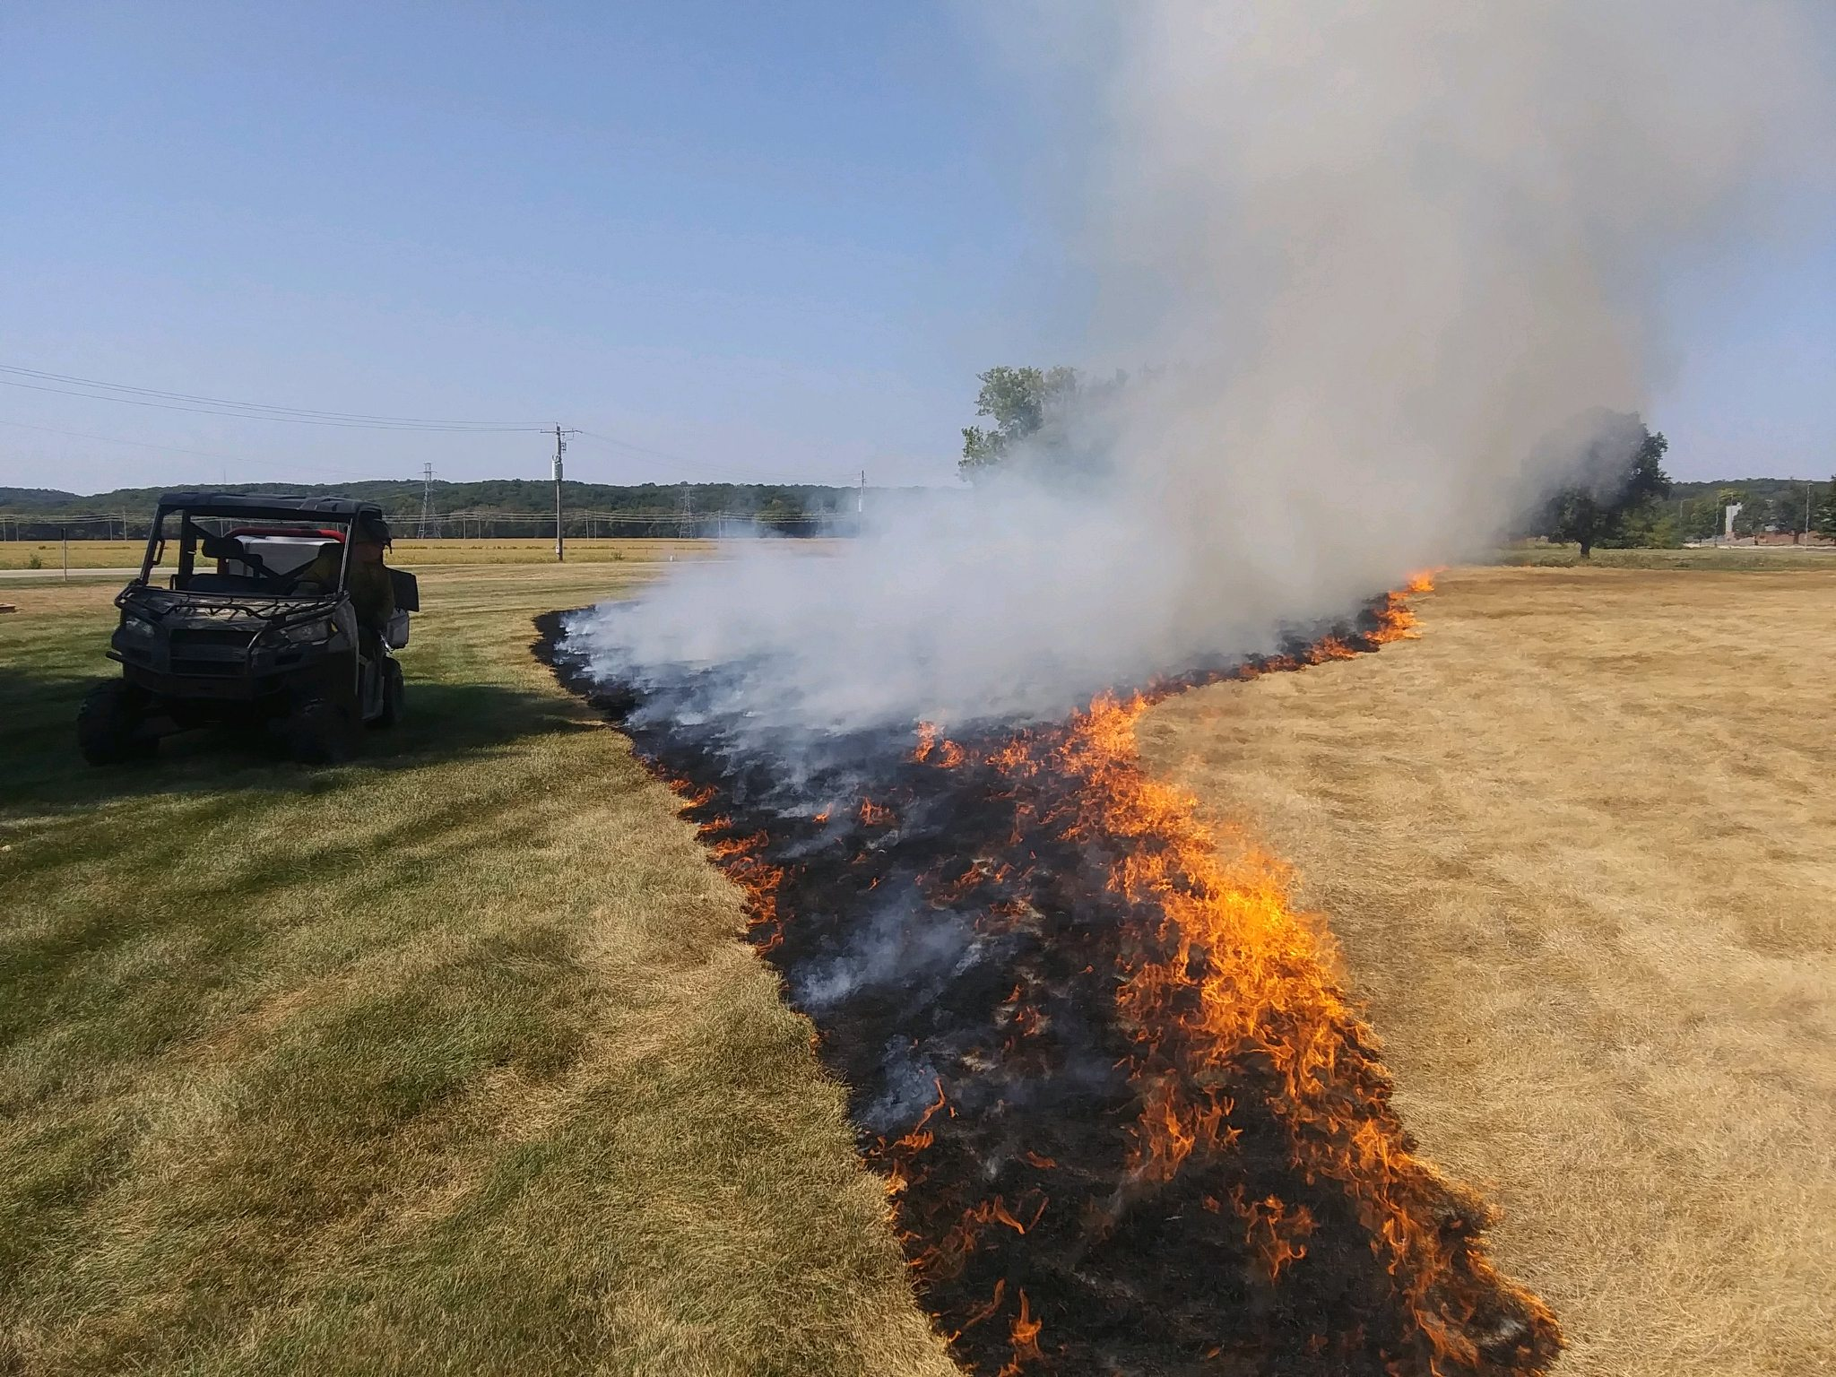
Conduct prescribed burn to remove dead vegetation

Slide 3
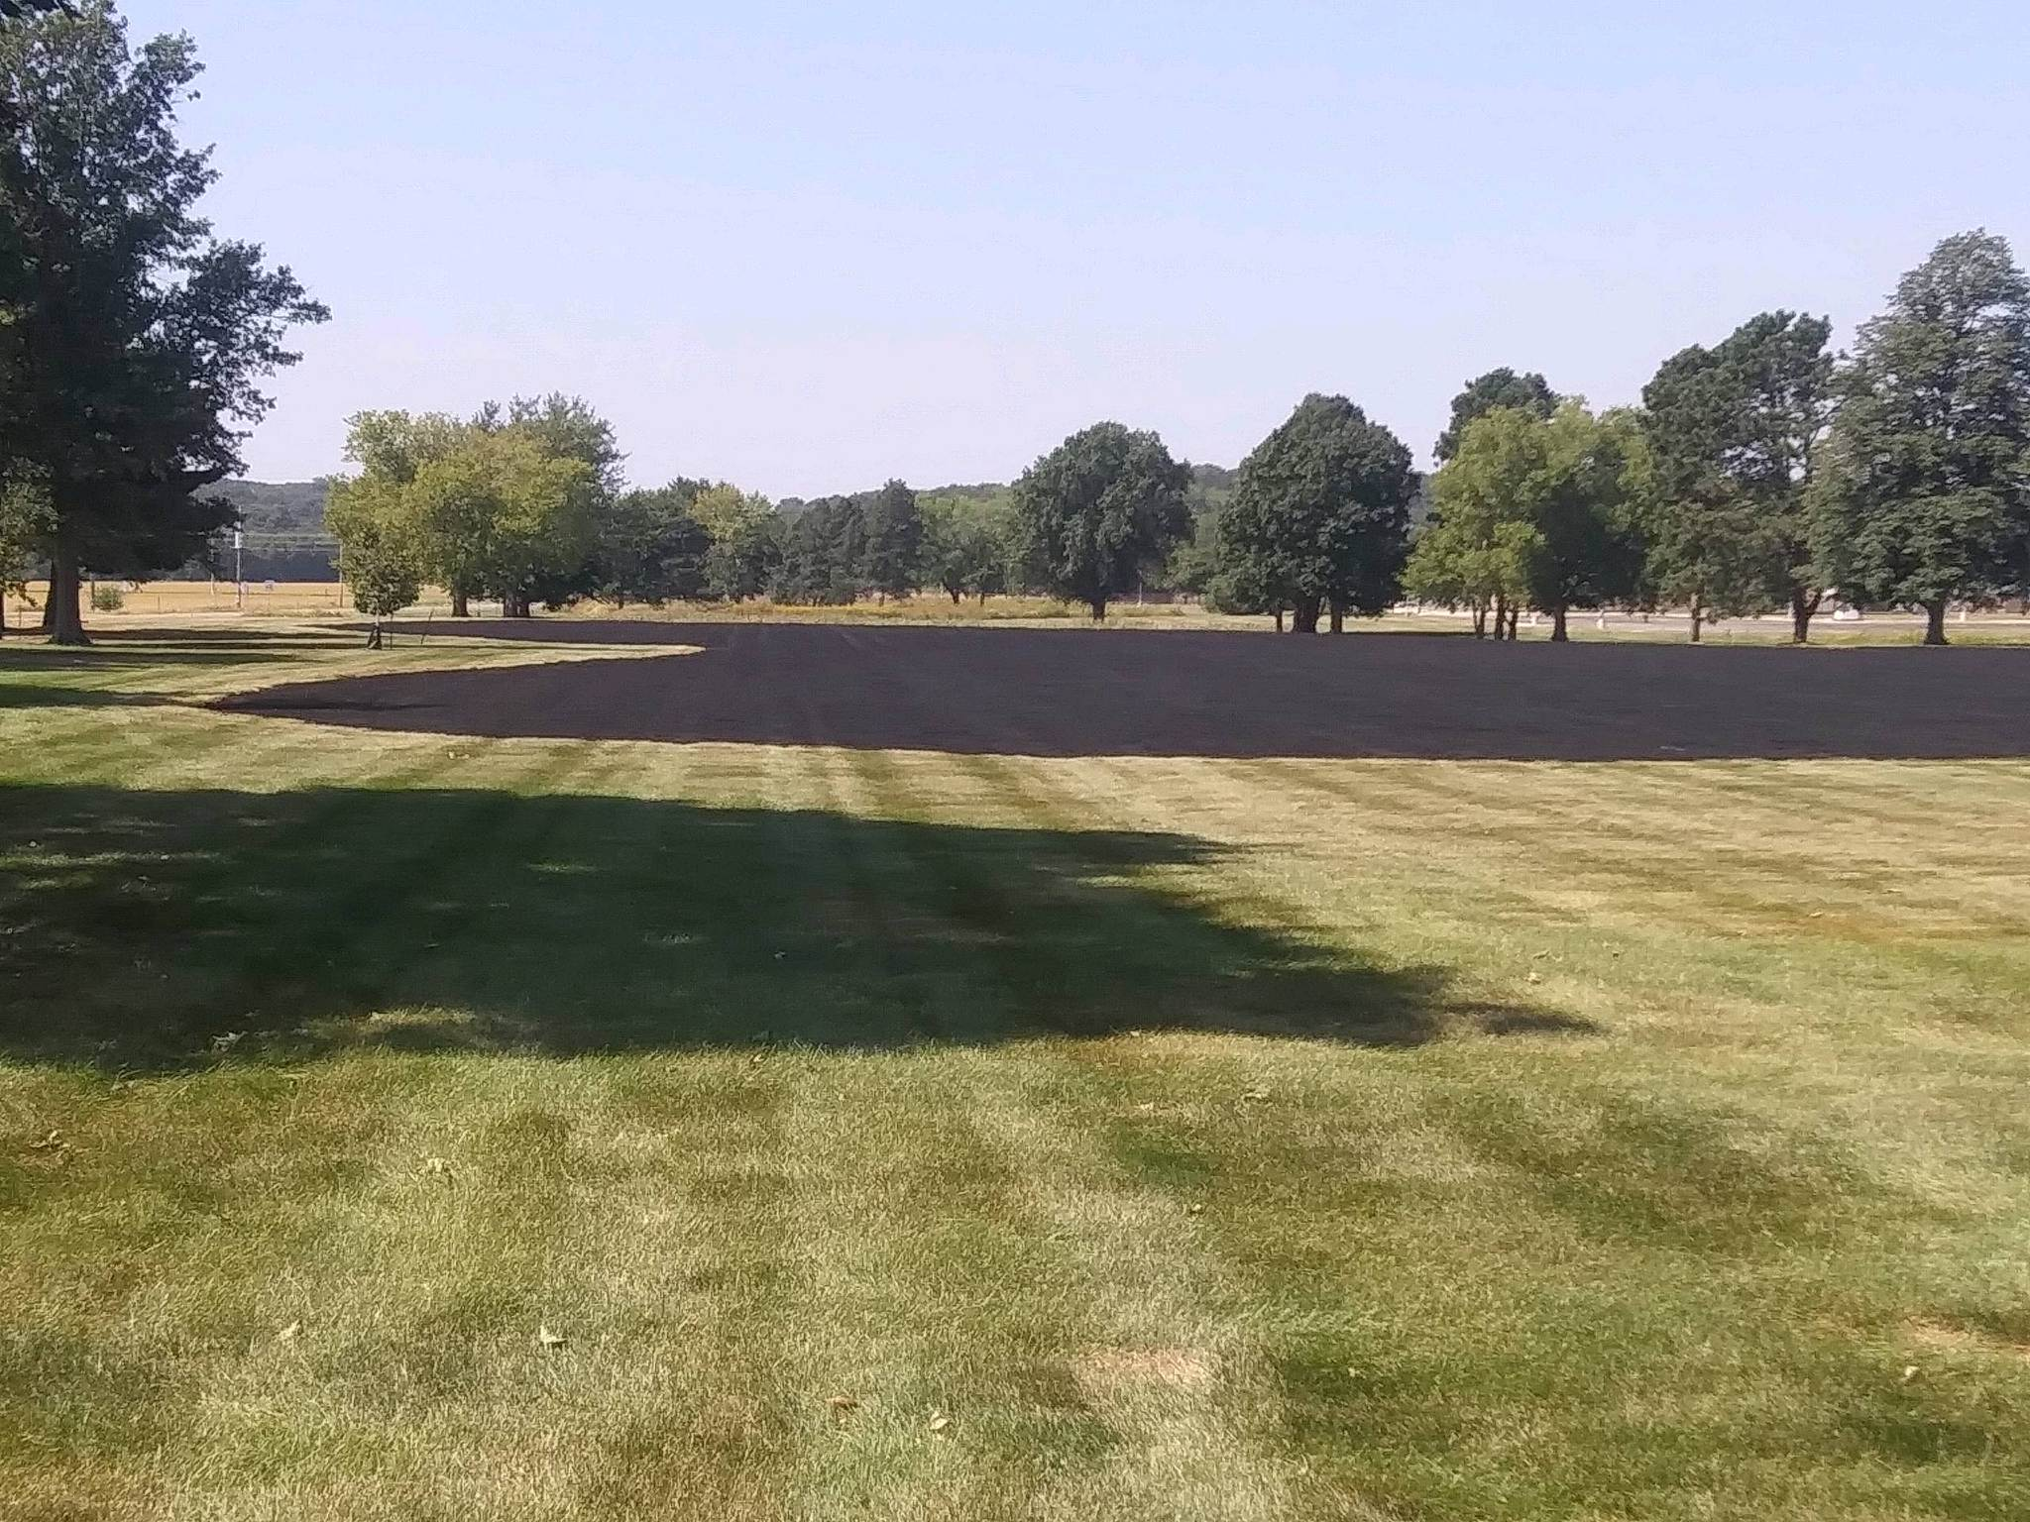
Unit is ready for seed

Slide 4
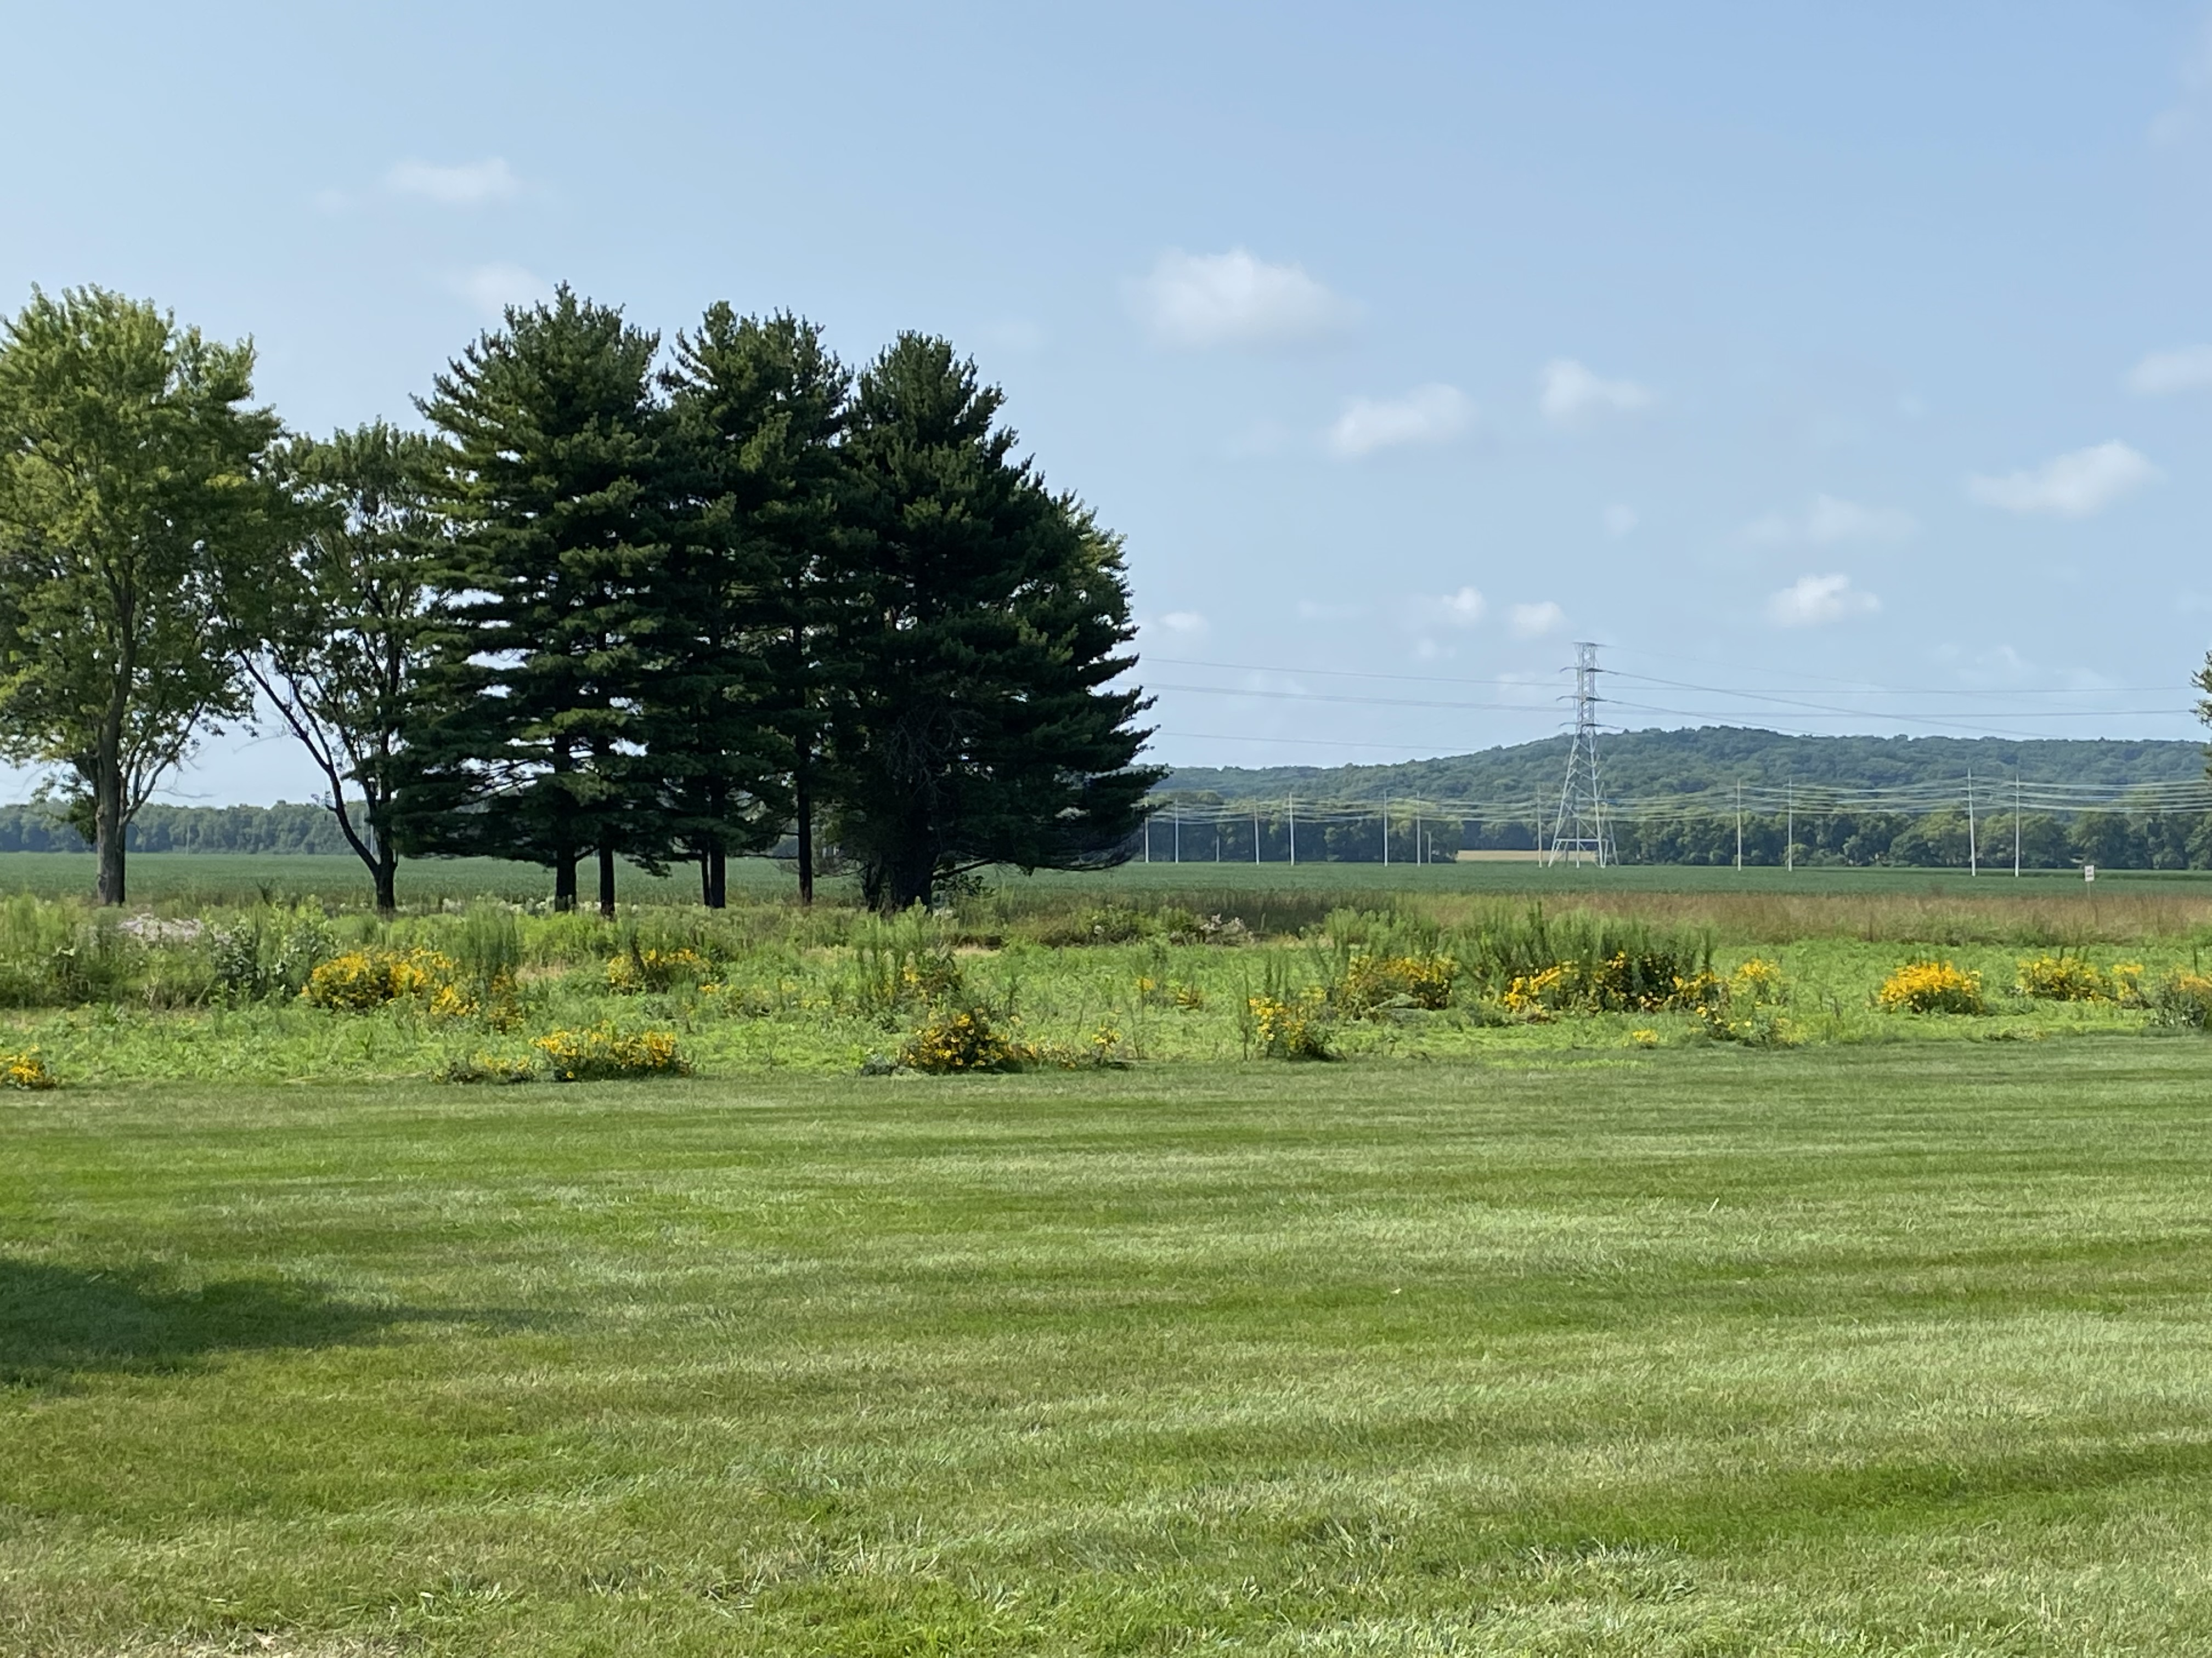
Expectations Year One:
Rough mowed look
Clean mowed edge surrounding the prairie seeding
Pockets of black eyed Susan and other native species taking hold

Slide 5
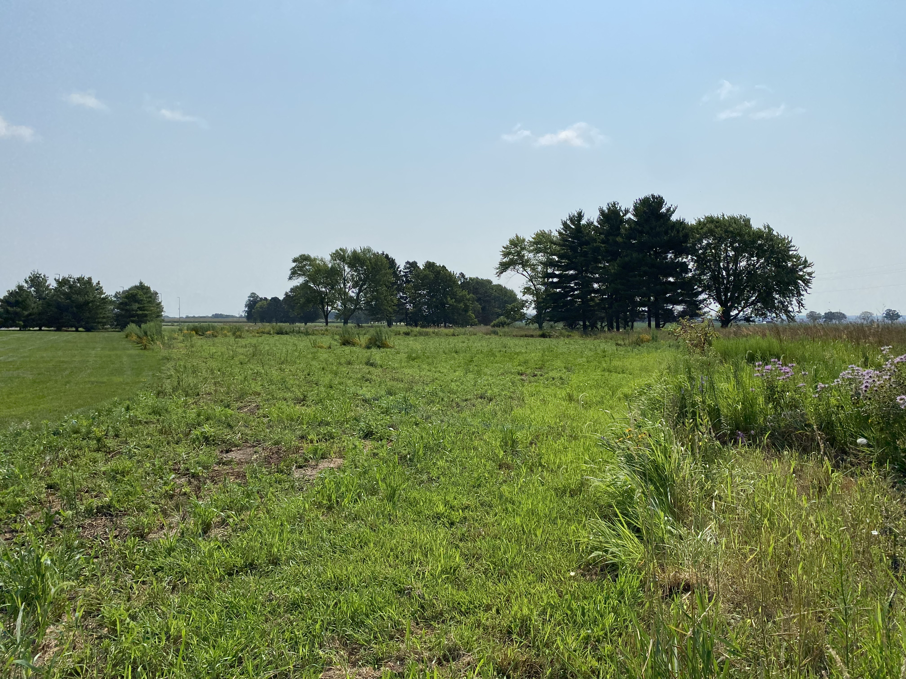
Expectations Year One (cont):
Patches of bare soil and annual weeds present
Bare areas necessary for seed colonization
New seeding (left) and established prairie (right)

Slide 6
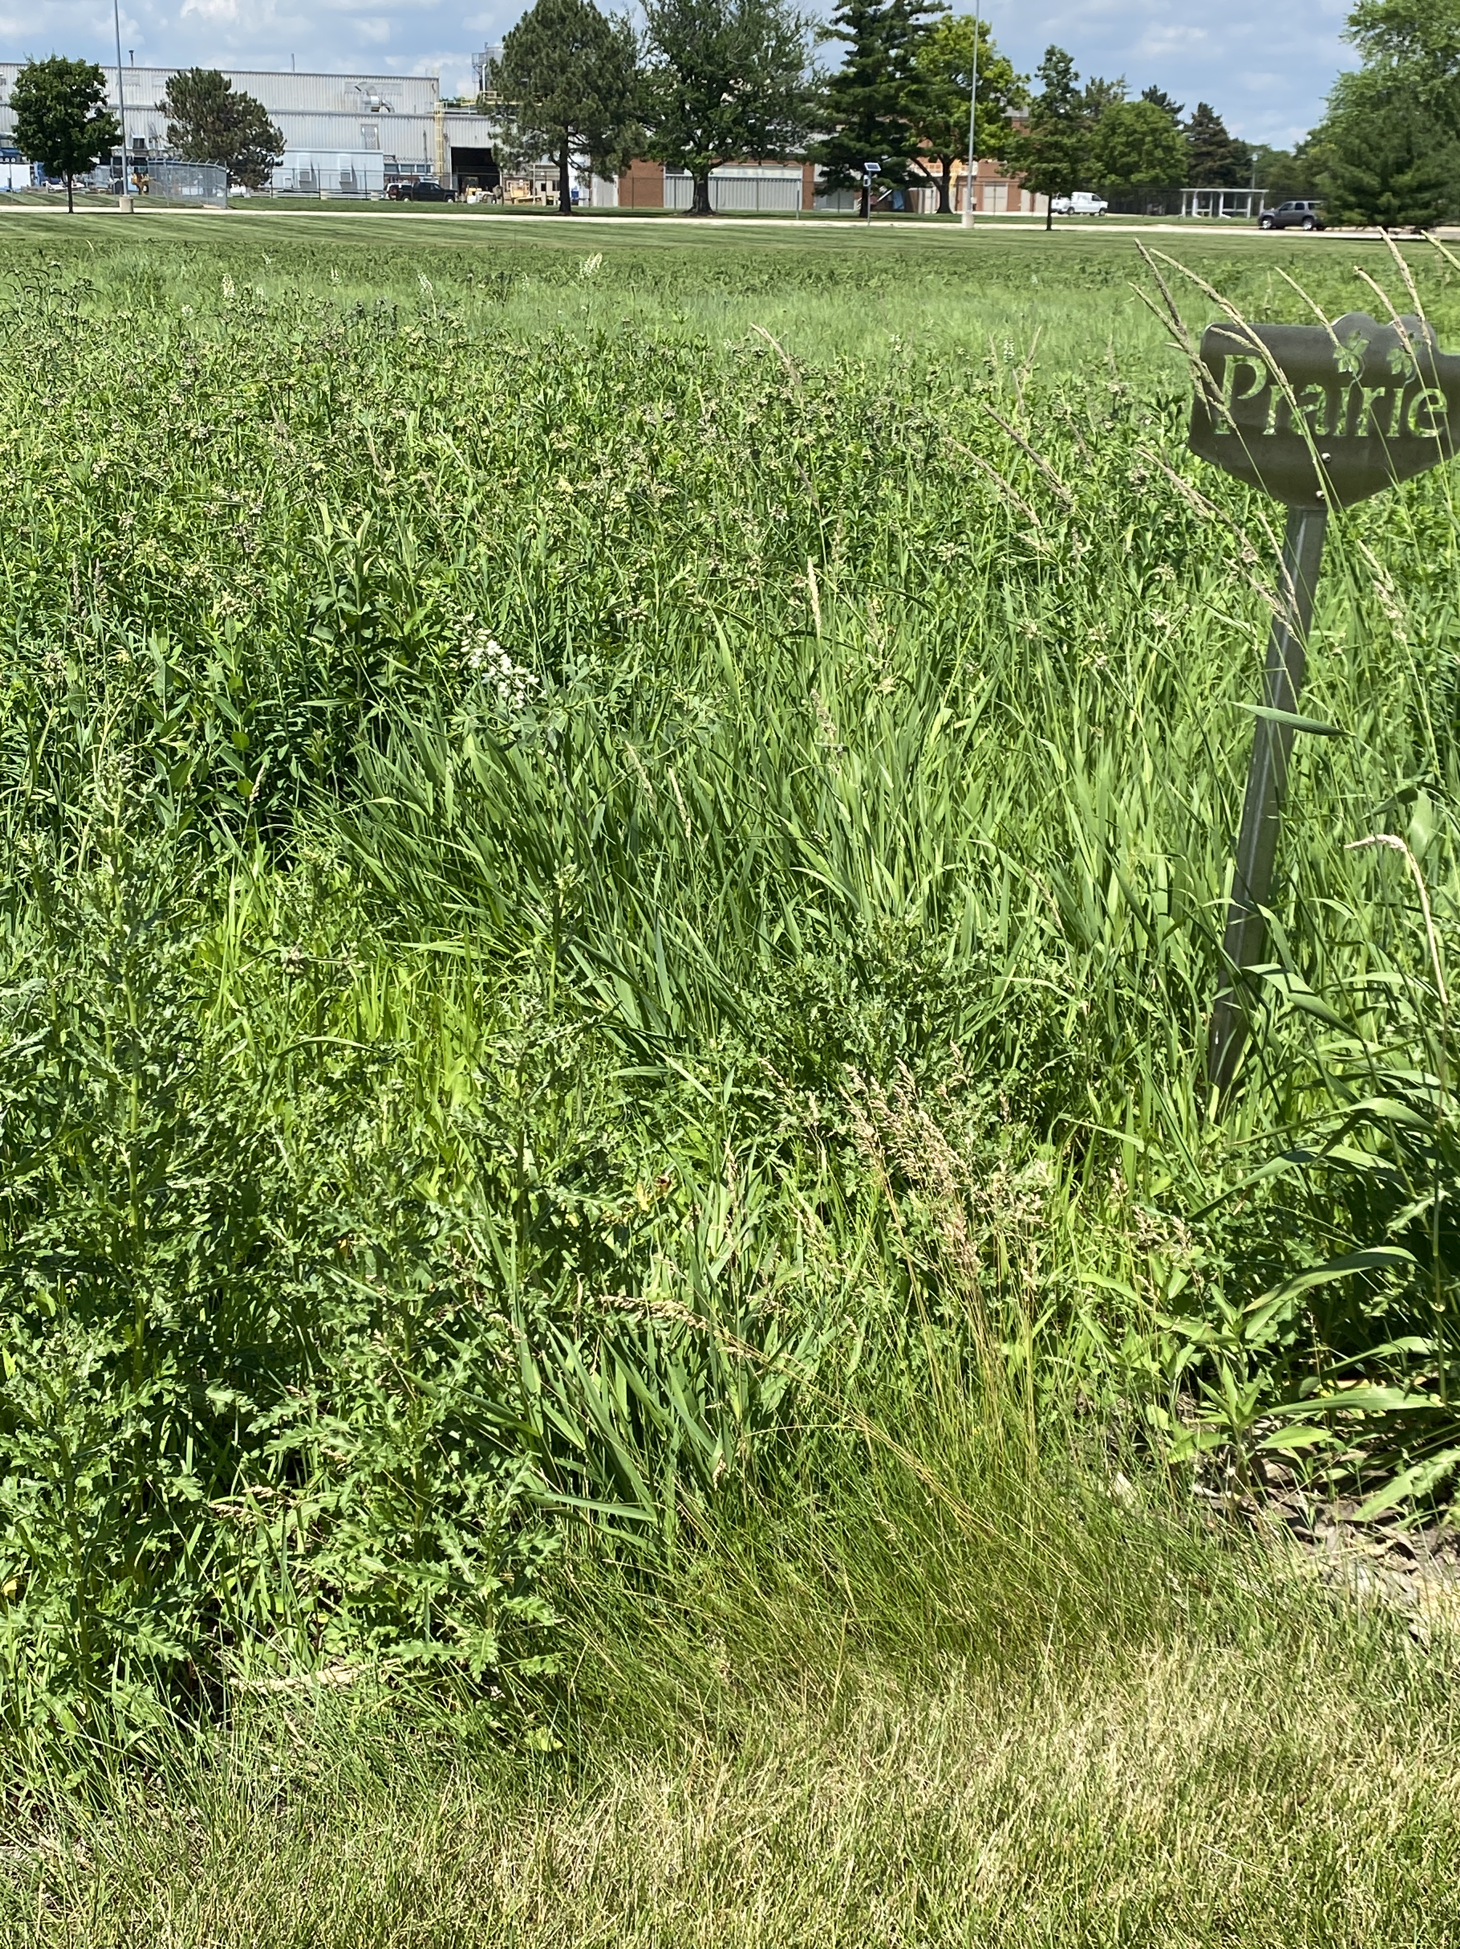
Expectations Year Two:
Second year requires close monitoring for perennial weed problems as more native species colonize. Natives are still building extensive root systems.

Slide 7
Expectations Year Two:
Conduct prescribed burn as soon as there are enough grasses to carry flames.

Slide 8
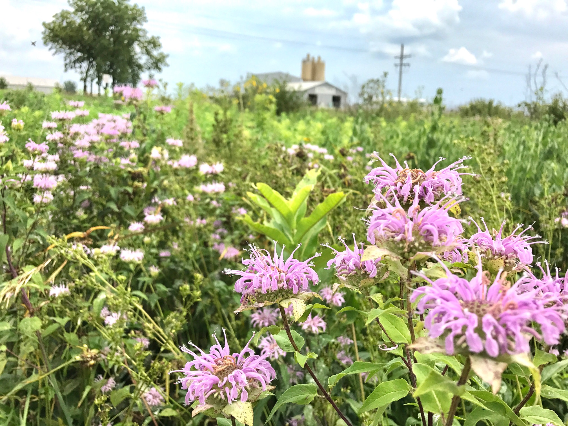
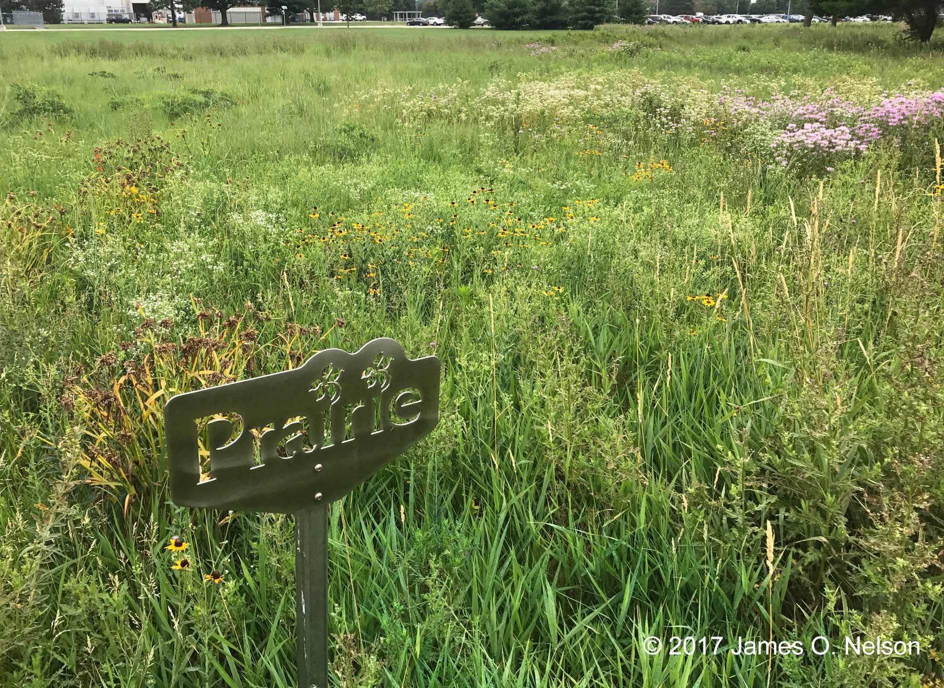
Expectations Year Three & beyond:
In years three to five, prairie establishment should be achieved. Establishment means a matrix of grasses, punctuated by occasional flowering plants, has been achieved.

